Slide 1
Lecture 7: Software Defined Networks
CS5229 Advanced Computer Networks

Slide 2
Thank you for filling up the Midterm Survey

Slide 3
Highlights of Midterm Survey
55% have no idea what is going on half the time
25% think the lectures are pretty good
42% have not done networking before! ☹

Slide 4
Good
Generally positive remarks about lecture
- enthusiastic, interesting, can learn a lot

Slide 5
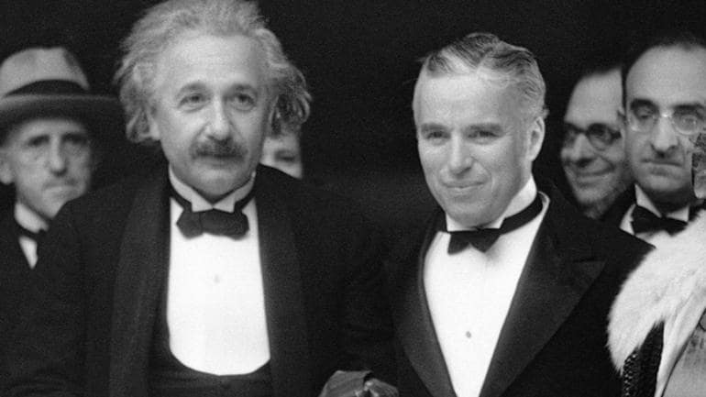

Slide 6
Good
Generally positive remarks about lecture
- enthusiastic, interesting, can learn a lot
“can follow if I read the papers before class.”
“I like the focus on context, would be great if this is brought up every time as we learn something new to connect the dots.”

Slide 7
Good
Most student think that the trainings are good! ☺
Some think they are hard
Some think they are easy
Many students think that the programming assignments are good
Some think they are too hard

Slide 8
Bad
Too much material/workload
Hard to understand the papers
Too fast
Too much congestion control
Not sufficiently industry-oriented
Complaints about Floodlight documentation

Slide 9
Ugly (Suggestions)
“I hope we can cover topics which are more practical to our future work(software engineering related). Maybe something like gRPC?”
“Can we get the slides before the lecture?”
“I don't like choice questions. Can it change to a short critique for each paper?”
“Can the slides have more details?”

Slide 10
Thank You
Many appreciate that this is a new course.
Many appreciate that it is difficult to balance between parttime students and fulltime students.
Lack of background

Slide 11
Expectation Management
CS5229 is not an undergrad course
CS5229 is meant to breach the gap between undergrad and PhD research
(similar to equivalent courses at top schools)
NUS is not a polytechnic vocation institute
Details actually don’t matter.
Concepts matter

Slide 12
Course Adjustments
Reduced reading list.
Week 12 Summary/Revision
Final Project: skills helpful in the industry
Made adjustments to HW + term project

Slide 13
1st Pass
Title, Abstract, Intro
Read sections, sub-sections, ignore the content
Conclusion
Check out references
Triage
13

Slide 14
2nd Pass
Look at the graphs
Mark references for future reading
Understand the key idea/ content
1 hour
14

Slide 15
3rd Pass
Identify assumptions
Mentally re-implement the paper
Key innovation/novelty, strengths & weaknesses
Can reconstruct paper from memory/teach
You are not going to get here
15

Slide 16
Quick Admin Notes
Project (part-2) details will be out this weekend
AWS Credits awarded
hw-2 due on 10 Oct 23:59
Questions?
16

Slide 17
Plagiarism Warning
NUS’ has tightened its plagiarism policy (cheating amidst the pandemic)
Term Project
Likely be the last assessment to be graded
Rigorous plagiarism checks
Any instance of cheating between 2 teams:
No choice, but to FAIL THE MODULE for all 6 students

Slide 18
Software-defined Networking

Slide 19

The Internet: A Remarkable Story
Tremendous success
From research experiment to global infrastructure
Brilliance of under-specifying
Network: best-effort packet delivery
Hosts: arbitrary applications
Enables innovation in applications
Web, P2P, VoIP, social networks, virtual worlds
But, the change is easy only at the edge… ☹
Credits: Adapted from Jennifer Rexford, Princeton

Slide 20
Inside the network, it’s a different story!

Slide 21
To understand better, let’s take a good look at a network switch

Slide 22
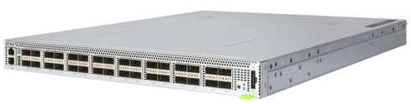
Network Switch
Metal chassis (box)
Edgecore Wedge100BF-32X
Front-panel Ports

Slide 23
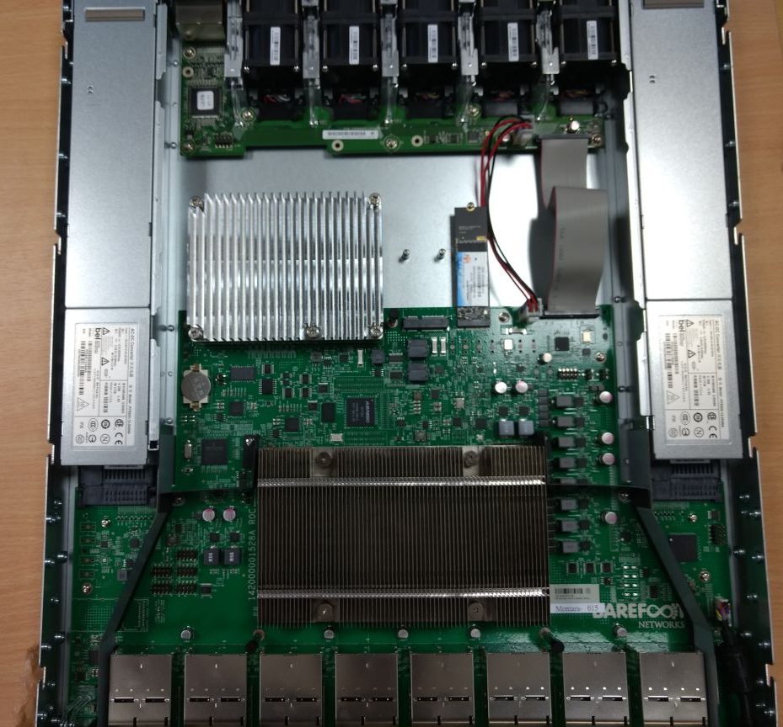
What’s inside a network switch?
Control Plane
Apps/Protocols: L2, BGP, etc.
Operating System (*nix)
ASIC driver
CPU + DRAM
PCIe Bus
Dataplane
Match-action tables
Processes almost all traffic in/out of front-panel ports (performs “forwarding” function)
Switching Chip (ASIC)
Front-panel Ports
Edgecore Wedge100BF-32X

Slide 24
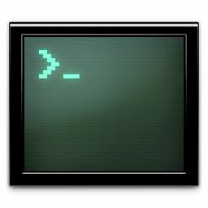

Logical view of a (traditional) Network Switch
Closed vendor-provided features/protocols: Routing, access control, VLANs, VPNs, …
Custom CLI/script interface
Device/vendor specific
Control Plane
100s pages user manuals
L2
BGP
VLAN
Millions of lines
of source code
7,000 Internet RFCs
Closed Operating System
Closed Interface (driver)
Custom & Fixed Forwarding Hardware
Billions of gates
Bloated Power Hungry
DataPlane
Credits: Adapted from Nick Mckeown, Stanford/Intel

Slide 25
Inside the Network: A Different Story
Closed equipment
Software bundled with hardware
Vendor-lock in
Expensive equipment
Vendor-specific interfaces (CLI)
Over specified
7000 Internet RFCs
Slow protocol standardization
Few people can innovate
Equipment vendors write the code
Long delays to introduce new features
Credits: Adapted from Jennifer Rexford, Princeton

Slide 26



Networks are Hard to Manage
Operating a network is expensive
More than half the cost of a network
Yet, operator error causes most outages
Buggy software in the equipment
Routers with 20+ million lines of code
Cascading failures, vulnerabilities, etc.
The network is “in the way”
Network owners/operators who want control over their network
Credits: Adapted from Jennifer Rexford, Princeton

Slide 27
Networks today are run by…
“Masters of Complexity”
Credits: Adapted from Nick Mckeown, Stanford/Intel

Slide 28
BUT, complexity does exist across Computer Systems
Abstractions to the rescue!

Slide 29
Abstractions in Computer Systems
Virtual memory: Abstract illusion of infinite, private physical memory
File system: Uniform illusion of read/write data store
Operating system: Shields user from CPU scheduling and peripheral sharing
(Traditional) Networking: ???
Cannot simply say: “Block all inbound ssh connections”
Think of vendor-specific CLI commands
Often operator-led misconfigurations and outages
Credits: Adapted from Nick Mckeown, Stanford/Intel
Notes:
Now, let’s look at

Slide 30
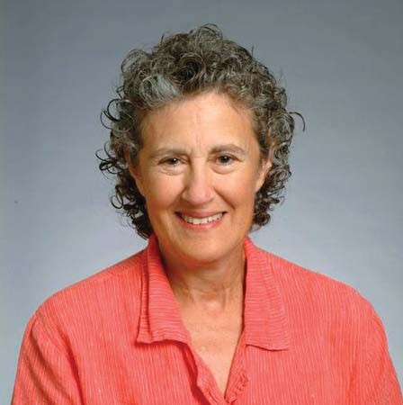
“Modularity based on abstraction is the way things are done!”
Barbara Liskov (MIT)
Turing Award Lecture 2009
Credits: Adapted from Nick Mckeown, Stanford/Intel

Slide 31
An abstraction for Networking
Idea behind the abstraction
Operating system: decouple policy and mechanism
e.g. Compiled C binary (computes 2+2=4) can run on both Intel and AMD CPUs
Network: decouple control plane (policy) and dataplane (mechanism)
e.g. Same (high-level) L2 learning program should run on both Cisco and Arista switches
Abstractions are made possible by open/standard interfaces
Operating system: x86_64 instruction set (Intel, AMD processors)
Network: ??

Slide 32
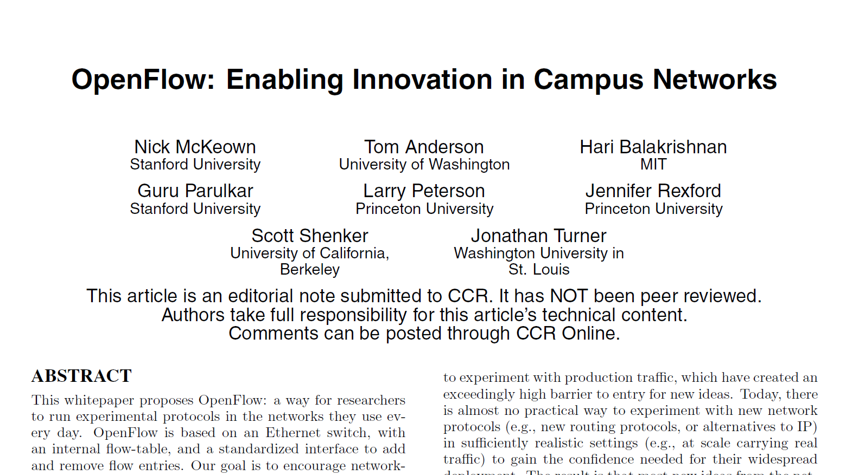
An interface for Networking
SIGCOMM CCR 2008
First open and standard interface for networking

Slide 33
Software-defined Networking (SDN 1.0)

Slide 34
SDN: An early definition (2008)
A network in which the control plane is physically separate from the forwarding plane.
and
A single control plane controls several forwarding devices.
(Evolved over time)
Credits: Adapted from Nick Mckeown, Stanford/Intel

Slide 35

SDN 1.0: Two Key Ideas
1. Decouple the switch’s control and data planes
Centralize the control plane
2. Use a standard and open interface between the two planes

Slide 36

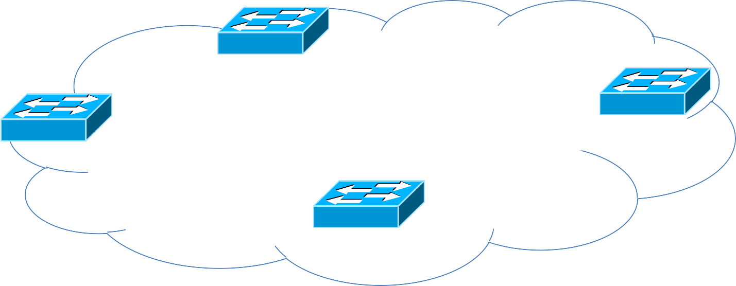





A traditional network before SDN 1.0
HPE
Data plane: Packet processing
Forward, filter, buffer, mark, rate-limit, and measure packets (fast timescales: per-packet)
Arista
Cisco
Juniper
Credits: Adapted from Jennifer Rexford, Princeton
Notes:
To get a high-level picture, let’s look at a traditional network before SDN 1.0

Slide 37












A traditional network before SDN 1.0
Control plane: Distributed algorithms
HPE
Arista
Cisco
Juniper
Track topology changes, compute routes, install forwarding rules
(slow timescales: per control event )
Credits: Adapted from Jennifer Rexford, Princeton

Slide 38

A traditional network before SDN 1.0
Managing a traditional network
Use different CLI to talk to different control plane apps
Box-by-box configuration
HPE CLI
Control plane: Distributed algorithms
Control Plane
Cisco CLI
Arista CLI
L2
BGP
VLAN
Juniper CLI
HPE
Closed Operating System
Arista
Cisco
Closed Interface (driver)
Juniper
Custom & Fixed Forwarding Hardware
Track topology changes, compute routes, install forwarding rules
DataPlane
Credits: Adapted from Jennifer Rexford, Princeton Work illustrations by Storyset
Notes:
Recall our logical view of a network switch
- On each switch: Vendor specific control plane talking to vendor specific dataplane with a vendor specific interface (driver)

Slide 39
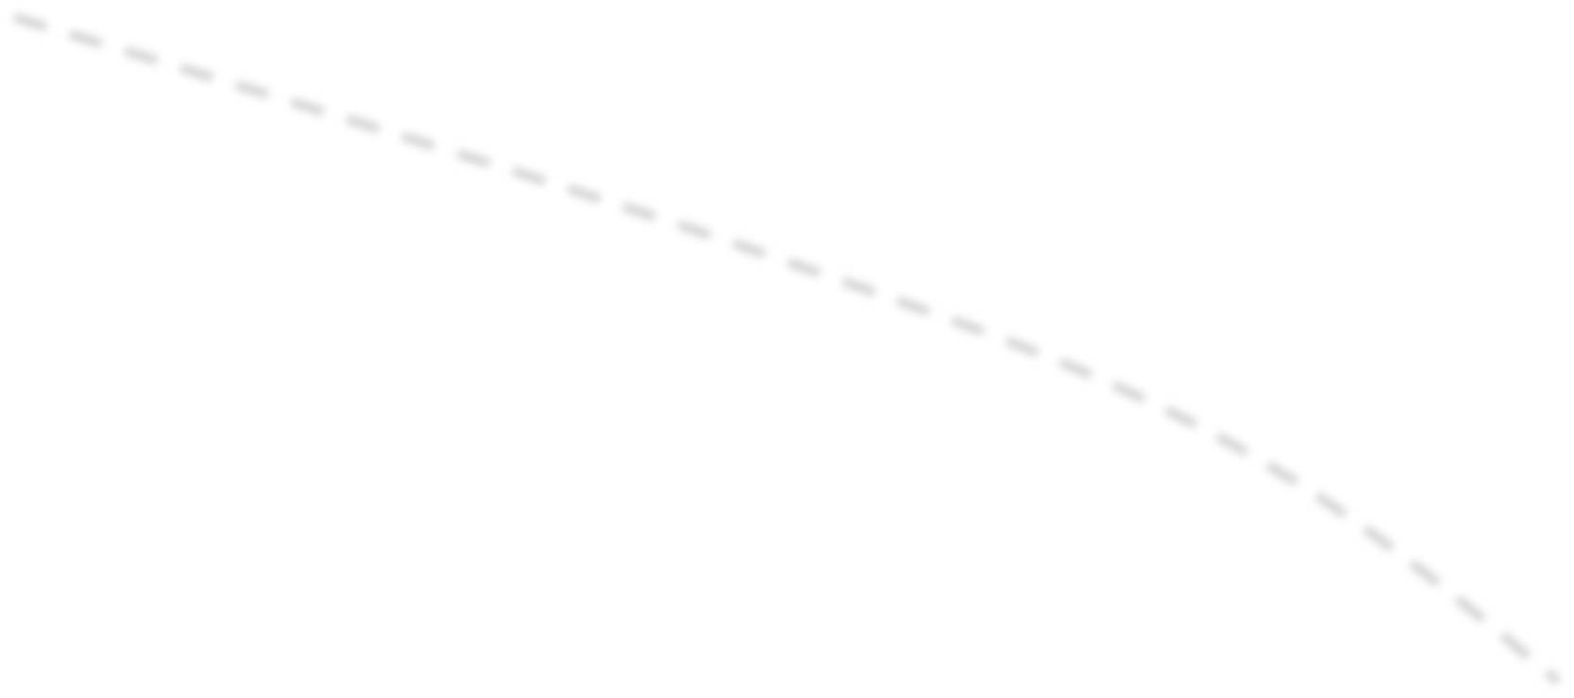




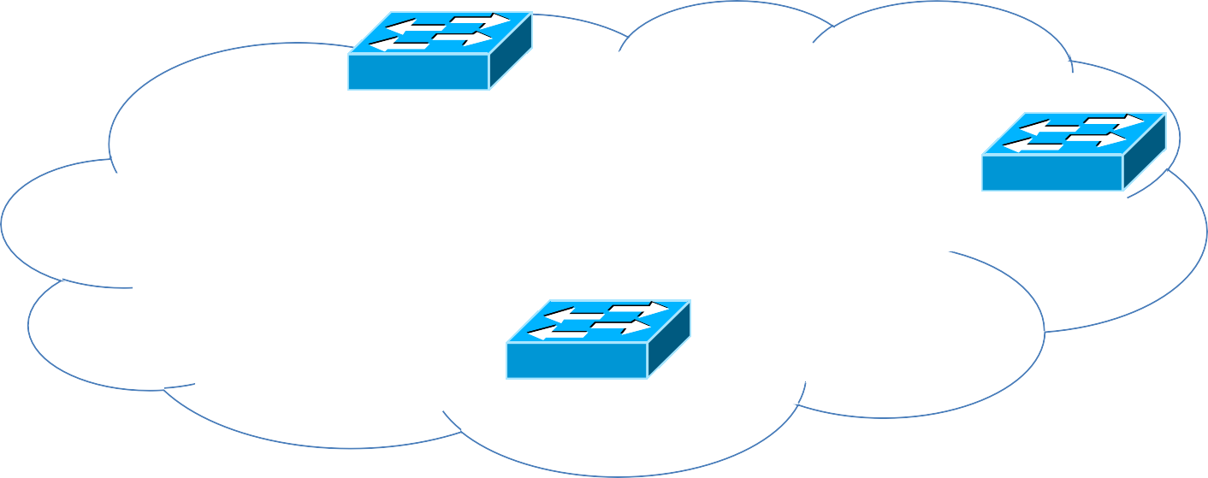





SDN 1.0
Generic APIs
Logically-centralized open control plane
Smart & slow
Open and standard interface to the data plane (e.g., OpenFlow)
HPE
Arista
Cisco
Switch Dataplane
Dumb & fast
Juniper

Slide 40
SDN 1.0
Recall: switch dataplane ➔ switching chip
Idea of SDN: use OpenFlow protocol to talk to the dataplane
Q. Does it mean that we change the switching chips to understand OpenFlow?

Slide 41
No! Switch vendors would not do it for various reasons.
Notes:
Take years for all vendors to agree on certain protocol
network equipment vendors are understandably nervous, about opening up interfaces inside their boxes: they have spent years deploying and tuning fragile distributed protocols and algorithms, and they fear that new experiments will bring networks crashing down.
And, of course, open platforms lower the barrier-to-entry for new competitors.

Slide 42
OpenFlow’s Practical Approach
Key Observation
All network switches contain flow tables
Implement L2/L3 forwarding, NAT, firewall, etc. that run at line rate
Flow tables in each vendor’s switching chip are different
But, match-action paradigm: match certain pkt hdrs, take certain actions
OpenFlow’s Key Idea
Common set of matching headers and corresponding actions supported by most existing switches
OF Protocol: msgs to manipulate flows tables using the common set
Switch vendors only provide a software middleware:
Translates OF msgs to vendor-specific interface between control and data planes

Slide 43
OpenFlow’s Practical Approach
L2
BGP
VLAN
Centralized Control Plane
Control Plane
Control Plane
L2
BGP
VLAN
OpenFlow Agent
Closed Operating System
Closed Operating System
Closed Interface (driver)
Vendor-specific
Interface (driver)
Closed Interface (driver)
Custom & Fixed Forwarding Hardware
Custom & Fixed Forwarding Hardware
Traditional Network Switch
OpenFlow Network Switch
Note: The switch still remains closed. Except the OF agent’s standard interface

Slide 44
















Real world OpenFlow Network
High-level languages: Python, Java, C++, etc.
Control Program
Control Program
Control Program
Northbound
Interface
Control Plane “Network Operating System (NOS)”
Global Network Map
Counters/statistics
Southbound
Interface
CP Agent
Dataplane
CP Agent
Dataplane
CP Agent
CP Agent
Dataplane
Dataplane
CP Agent
Dataplane
Credits: Adapted from Nick Mckeown, Stanford/Intel

Slide 45
Reconciling with SDN Programming Assignments
High-level language: ??
Control Program
Control Program
Control Program
Northbound
Interface ??
Control Plane “Network Operating System (NOS)”
??
CP Agent
Southbound
Interface ??
Dataplane
CP Agent
Dataplane
CP Agent
CP Agent
Dataplane
Dataplane
CP Agent
Dataplane
Credits: Adapted from Nick Mckeown, Stanford/Intel

Slide 46





Working of an OpenFlow Network
Dataplane has simple packet-handling rules
Pattern: match packet header bits
Actions: drop, forward, modify, send to controller
Priority: disambiguate overlapping match patterns
Counters: #bytes and #packets
1. src=1.2.*.*, dest=3.4.5.* ➔ drop
2. src = *.*.*.*, dest=3.4.*.* ➔ forward(2)
3. src=10.1.2.3, dest=*.*.*.* ➔ send to controller
Credits: Adapted from Jennifer Rexford, Princeton

Slide 47
Unifies Different Kinds of Boxes
Router
Match: longest destination IP prefix
Action: forward out a link
Switch
Match: dest MAC address
Action: forward or flood
Firewall
Match: IP addresses and TCP
/UDP port numbers
Action: permit or deny
NAT
Match: IP address and port
Action: rewrite addr and port
Credits: Adapted from Jennifer Rexford, Princeton

Slide 48

SDN 1.0: Full Programmability of the Control Plane
Controller Applications
Network OS
Events from switches Topology changes, Traffic statistics, unmatched arriving packets
Commands to switches (Un)install rules, Query statistics,
Send packets
Credits: Adapted from Jennifer Rexford, Princeton

Slide 49
Usecases of SDN 1.0

Slide 50

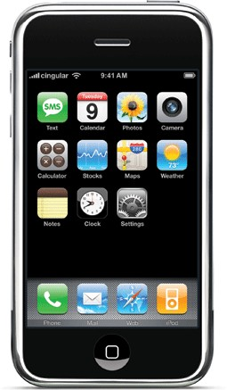


Dynamic Access Control
Inspect first packet of a connection
Consult the access control policy
Install rules to block or route traffic
Credits: Adapted from Jennifer Rexford, Princeton

Slide 51

Seamless Mobility/Migration
See host send traffic at new location
Modify rules to reroute the traffic
Credits: Adapted from Jennifer Rexford, Princeton

Slide 52
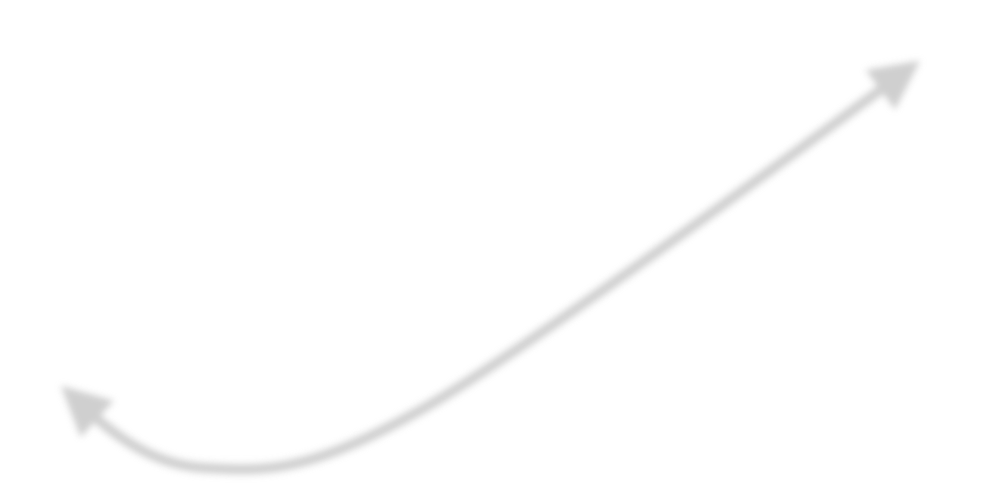


Server Load Balancing
Pre-install load-balancing policy
Split traffic based on source IP
src=0*
src=1*
Credits: Adapted from Jennifer Rexford, Princeton

Slide 53
Network Virtualization
Controller #1
Controller #2
Controller #3
10.*.*.*
20.*.*.*
30.*.*.*
Partition the space of packet headers
Credits: Adapted from Jennifer Rexford, Princeton

Slide 54
Benefits of Separation
Independent evolution and development
The software control of the network can evolve independently of the hardware.
e.g. Same L2 learning control plane app works for different switches
High-level control plane applications
Control behavior using higher-order programs
Debug/check behavior more easily (e.g. formal verification)

Slide 55
Benefits of Centralization
Centralized decisions are easier to make
e.g., OSPF (RFC 2328) 244 pages
Distributed system part (builds consistent network 100 pages)
Routing algorithm (Dijkstra’s algorithm 4 pages)
Logically vs. physically centralized
Issues of a physically centralized controller?
How to implement a logically centralized one?
Using distributed systems principles: replication and fault-tolerance

Slide 56
OpenFlow in the Wild
Open Networking Foundation
Google, Facebook, Microsoft, Yahoo, Verizon, Deutsche Telekom, and many other companies
Commercial OpenFlow switches
Intel, HP, NEC, Quanta, Dell, IBM, Juniper, …
Network operating systems
NOX, Beacon, Floodlight, Nettle, ONIX, POX, Frenetic, OpenDayLight
Network deployments
Data centers
Cloud provider backbones
Public backbones
Credits: Adapted from Jennifer Rexford, Princeton

Slide 57
Overall impact of SDN 1.0
Simpler management
Open, centralized and fully programmable control plane
Faster pace of innovation
Less dependence on vendors and standards
Easier interoperability
Compatibility only in “wire” protocols
Simpler, cheaper equipment
Minimal software
Credits: Adapted from Jennifer Rexford, Princeton

Slide 58
SDN 1.0 provided an abstraction for Networking
Highly simplified analogy with a CPU Operating System
App1
App2
AppN
App1
App2
AppN
OS
NOS
x86 ISA
OpenFlow
Any x86 CPU
(Intel, AMD, VIA, Zhaoxin)
Any OpenFlow Switch*
(HPE, Cisco, Juniper, Arista, Brocade, etc.)
* Network Switch = Packet Processing Unit
Final Note: SDN != OpenFlow

Slide 59
Q. SDN has a lot of benefits. Should we deploy SDN switches everywhere?
The Internet?
Campus/Enterprise Networks?
Datacenters?

Slide 60
Programmable Dataplanes

Slide 61
In the Beginning…
OpenFlow was simple
A single rule table
Priority, pattern, actions, counters, timeouts
Matching on any of 12 fields, e.g.,
MAC addresses
IP addresses
Transport protocol
Transport port numbers
Metadata fields: ingress_port
Credits: Adapted from Jennifer Rexford, Princeton

Slide 62
“Second System” Syndrome
OpenFlow 1.0 limitations
One (logical) flow table
Limited headers and actions
Sending packets to the controller
Later version of OpenFlow
More flow tables, headers, actions
But, still never enough
Where does it stop?!?
Version | Date | # Headers
OF 1.0 | Dec ‘09 | 12
OF 1.1 | Feb ‘11 | 15
OF 1.2 | Dec ‘11 | 36
OF 1.3 | Jun ‘12 | 40
OF 1.4 | Oct ‘13 | 41
OF 1.5.1 | Mar ‘15 | 44
Credits: Adapted from Jennifer Rexford, Princeton

Slide 63
Protocol Dependence of SDN 1.0
Consider the following action types (OpenFlow 1.5.1)
OFPAT_PUSH_VLAN = 17, /* Push a new VLAN tag */
OFPAT_POP_VLAN = 18, /* Pop the outer VLAN tag */
OFPAT_PUSH_MPLS = 19, /* Push a new MPLS tag */
OFPAT_POP_MPLS = 20, /* Pop the outer MPLS tag */
OFPAT_PUSH_PBB = 26, /* Push a new PBB service tag (I-TAG) */
OFPAT_POP_PBB = 27, /* Pop the outer PBB service tag (I-TAG) */
OpenFlow actions are tied to specific protocols

Slide 64
Dataplane dependence of SDN 1.0
Support VXLAN (new packet encapsulation protocol)
VXLAN protocol requires per-packet line-rate operations
Dataplane should first support the VXLAN protocol
VXLAN Flow Table: match on VXLAN header fields
Support actions: PUSH_VXLAN, POP_VXLAN, modify VXLAN
Then extend OpenFlow protocol: manipulate VXLAN flow table
Recall: OpenFlow open/standard interface to the existing flow tables in the switch dataplane (forwarding chip/ASIC)
Switch dataplane determines ultimate limit of programmability!

Slide 65
Q. Can we do better? Can we “program” a new protocol into the switch dataplane?

Slide 66
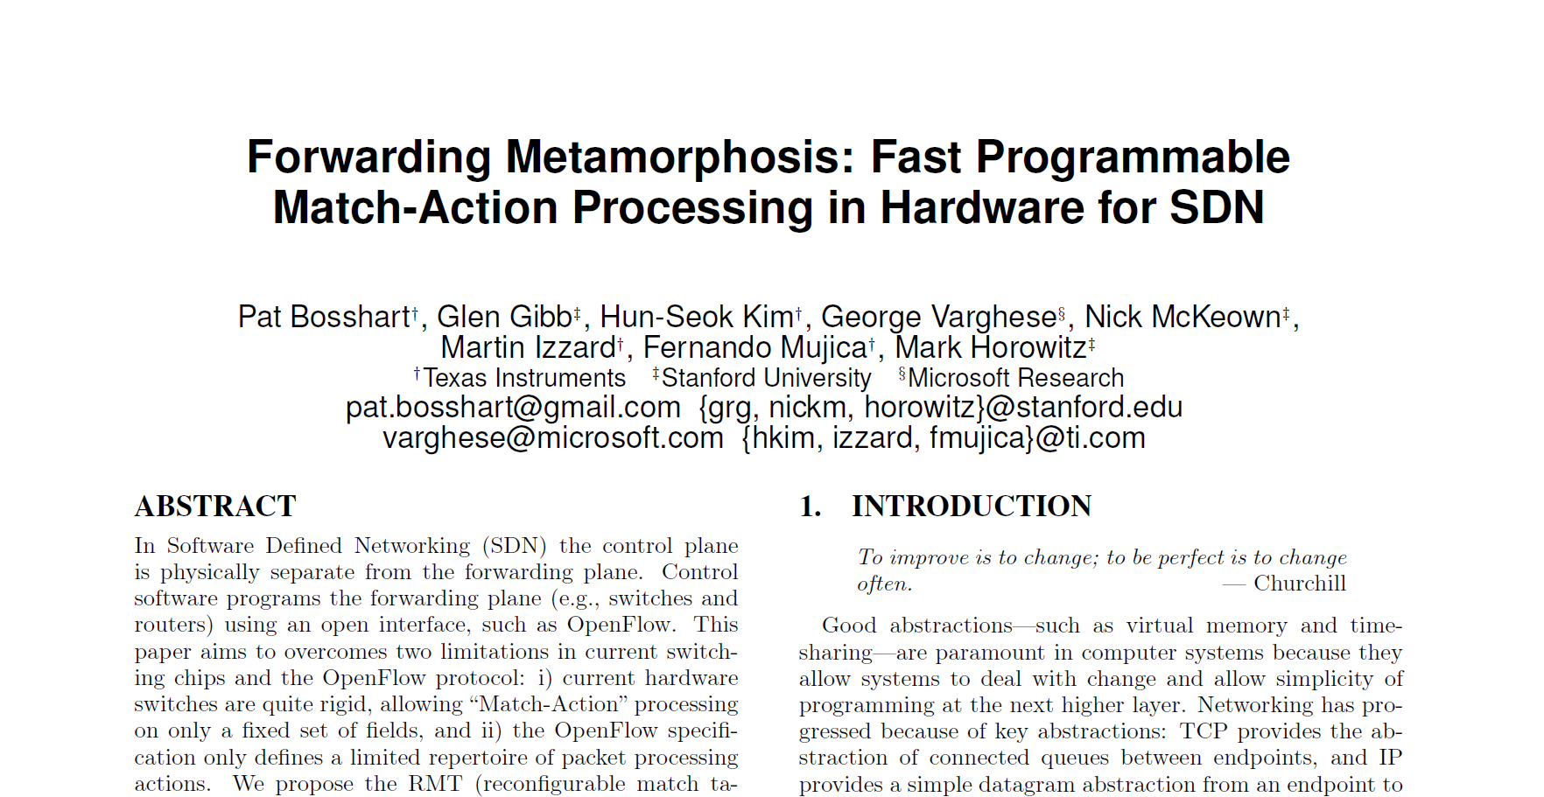
Reconfigurable Match Tables (RMT)
SIGCOMM 2013
Architecture of a programmable switching chip (dataplane)
Notes:
Yes! This paper, ‘forwarding metamorphosis’ made it possible. They proposed something called as the RMT

Slide 67
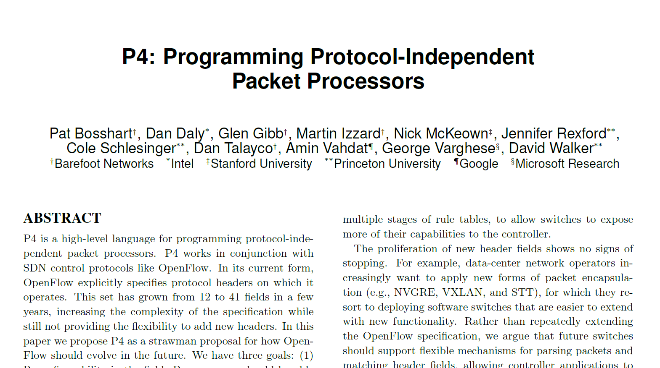
P4: Programming Protocol-Independent Packet Processors
SIGCOMM CCR 2014
Domain-specific language for a programmable switching chip

Slide 68
RMT + P4 → enable a programmable dataplane (SDN 2.0)

Slide 69
Main goal of P4: Protocol Independence
Key ideas to achieve protocol independence
Programmable parsing: tell the chip how to parse packets
e.g. if UDP dstPort == 4789, next header is VXLAN
Typed match-action tables: define your own match fields
e.g. new protocol’s header field like VXLAN ID
Programmable actions: define your own actions
e.g. push/pop VXLAN header, modify VXLAN ID, forward based on VXLAN ID

Slide 70
Programmable Actions in P4
Protocol-independent actions primitives
Used to defined custom actions
P4 can support future protocols (not known today)
More simple, elegant and future proof than OpenFlow 1.x
add_header() remove_header()
set_field() increment()
action add_vlan_hdr(){
add_header(vlan_hdr);
}
action add_vxlan_hdr(){
add_header(vxlan_hdr);
}

Slide 71
Limitations of a programmable dataplane
High-level constraint: all processing MUST maintain line rate
No “loop” constructs
No floating point computations
Only approximate computations possible

Slide 72
Impact of dataplane programmability (SDN 2.0)
Protocol independence
Faster and easier network evolution: new protocols/headers
Traditionally new protocol addition takes 4-5 years!!
Requires design and development of a new fixed-function switching chip
SDN 2.0 brings this time down to weeks/months.
Flexible Resource Allocation
Traditional switches: L2, L3, ACL, VLAN consume chip’s resources
SDN 2.0: define only the required tables
If using the box L3 router: just program L3 table with large # of entries
Throw away unused tables: simplified data and control planes
Helps reduce unwanted bugs

Slide 73
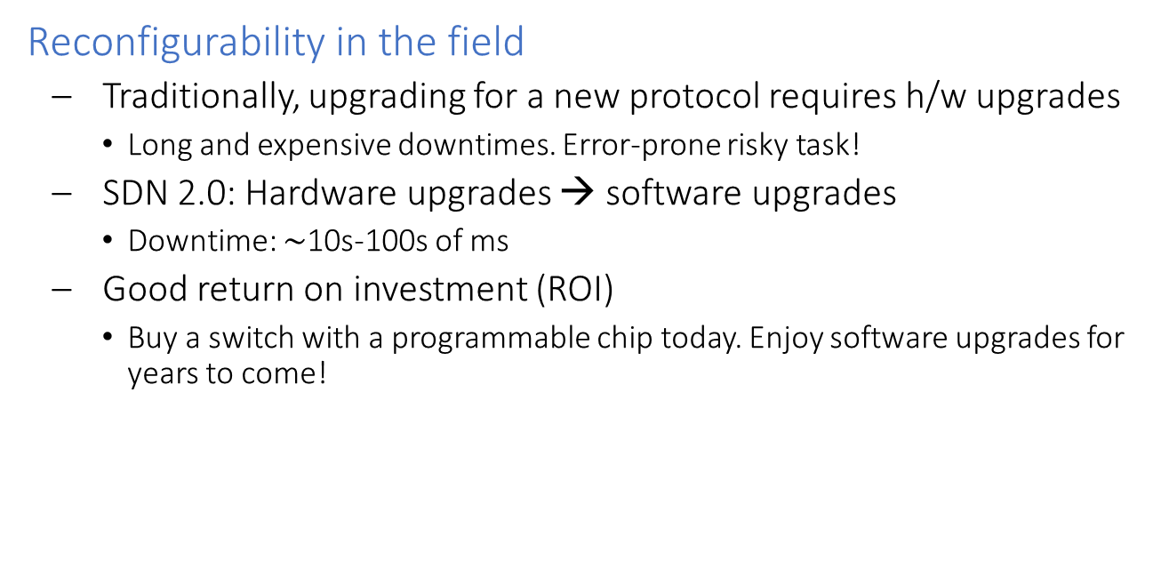
Impact of dataplane programmability (SDN 2.0)
Reconfigurability in the field
Traditionally, upgrading for a new protocol requires h/w upgrades
Long and expensive downtimes. Error-prone risky task!
SDN 2.0: Hardware upgrades → software upgrades
Downtime: $\sim$10s-100s of ms
Good return on investment (ROI)
Buy a switch with a programmable chip today. Enjoy software upgrades for years to come!

Slide 74
Dataplane Programmability in the wild
P4-programmable switching chips
Intel Tofino, Tofino2
Commercial switches with P4-programmable switching chip
Cisco, Arista, Edgecore, Inventec
SmartNICs
NetFPGA, Netronome, Xilinx
P4 also used to specify software packet processing
XDP, eBPF, OpenVSwitch
P4 has become the de-facto language to specify packet processing ☺

Slide 75
Features beyond protocol independence
Queuing Telemetry Information
Enqueue/dequeue queue depth (per-packet)
Time spent in the queue (per-packet)
Transactional Memory (SRAM) + Stateful ALUs
Stateful operations across multiple packets
Simple computations: add, subtract, approx. multiply/divide
High-resolution Timestamping
Nanosecond-scale timestamps
Packet cloning/replication
Flexible mirroring or conditional multicasts (at run time)

Slide 76
Value for Network Researchers
Previously
Cannot propose a dataplane-level solution
No way to prototype and validate. Simulations typically not accurate!
Today
Propose a dataplane-level solution for new/existing problems in networking/systems
P4 programmable platform: readily “realize” the solution in production hardware at full line rate (100G/400G)

Slide 77
Hottest topic in networking Research
In-Network Computing
In-network caching [NetCache, SOSP’17]
In-network chain replication [NetChain, NSDI'18, Best Paper]
In-network DDoS detection and mitigation [Jaqen, Security'21]
Programmable Packet Scheduling (AQMs)
[SP-PIFO, NSDI’20], [Calendar Queues, NSDI’20], [AIFO, SIGCOMM’21]
Co-designing distributed systems with the network
NOPaxos [OSDI‘16], Pegasus [OSDI’20] ← Week 11
Lot more papers on network telemetry and verification
Network verification: Both OpenFlow and P4 have opened up a whole new research area

Slide 78
Hottest networking topic in the Industry
Google
Using P4 to encode/specify the behavior of existing switches
Apply formal verification techniques: check correctness of configurations
Microsoft Azure
Protocol independence, Reconfigurability in the field (better ROI)
Kuaishou
Translating IPv6 traffic to IPv4 and vice-versa
AliBaba
NetSeer: tracking every single packet drop [SIGCOMM’20]
SailFish: Multi-tenant, multi-service gateways [SIGCOMM’21]
Already running in production
5G Usecases
Several companies: Accelerating UPF, slicing 5G networks

Slide 79
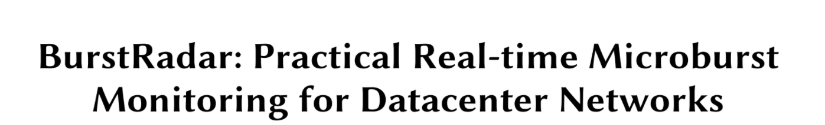
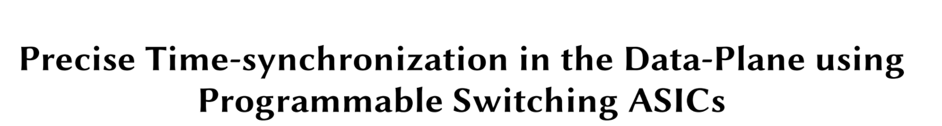
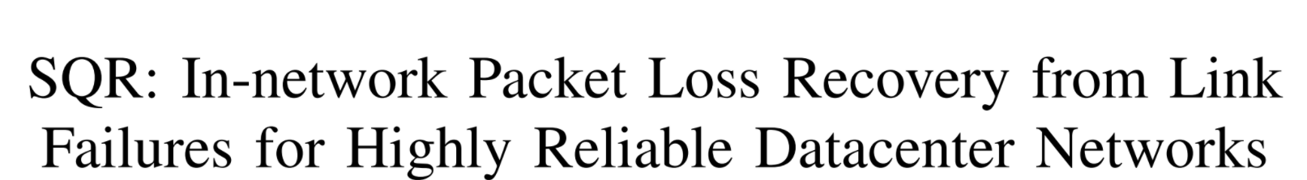
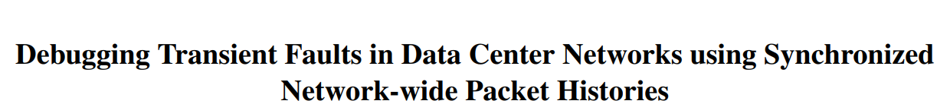
Networking Research using P4 @SoC
APSys’18
SOSR’19
ICNP’19
NSDI’21

Slide 80
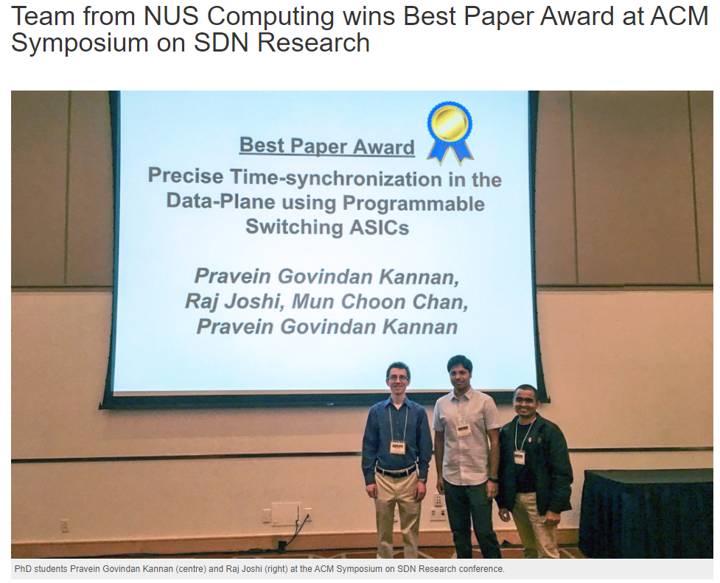
Networking Research using P4 @SoC

Slide 81
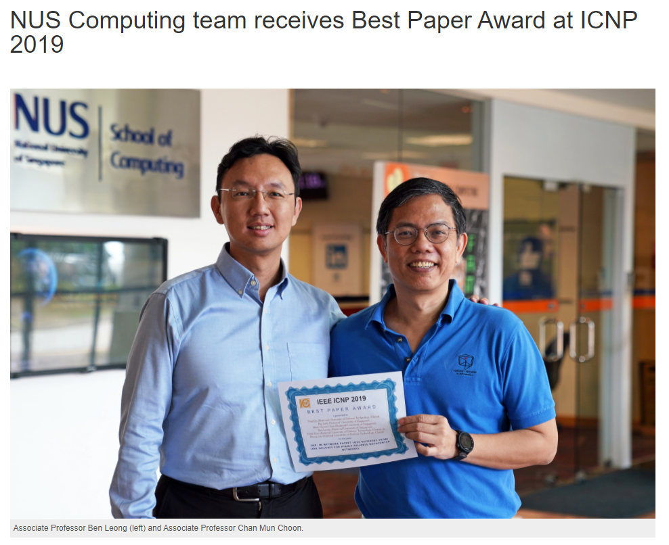
Networking Research using P4 @SoC

Slide 82
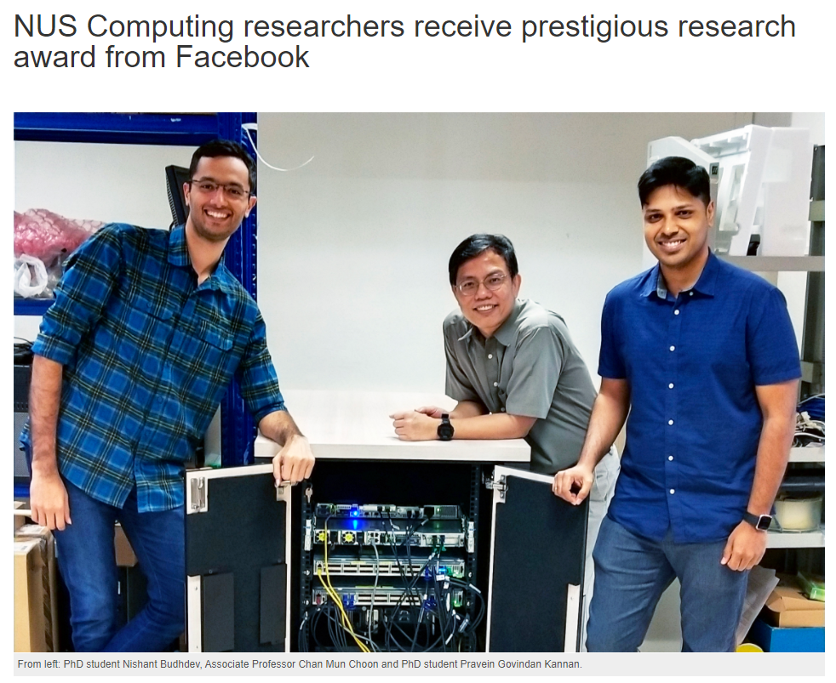
Networking Research using P4 @SoC

Slide 83
If you are interested, reach out!

Slide 84
Summary
Traditional Network Switches
Completely closed, vertically integrated
Only equipment vendors: drive the innovation and evolution
OpenFlow (SDN 1.0) made the control plane programmable
Provided an abstraction to manage and operate networks in s/w
P4 (SDN 2.0) took the s/w programmability to the dataplane
Made networking truly software-defined
SDN has enabled network owners and operations to take back the control of their network!

